Slide 1
From www.eclipse.org/osee to deployment
Tutorial
Ryan Brooks
Donald Dunne
Roberto Escobar
Boeing
Mesa, AZ

Slide 2
Agenda
Installation & Setup
OSEE
  What is it?
  Background Information
Architecture
  Network Layout
T. Rex Software Company
Data Model
Version Control
Variant Management
Break
Notes:
Hand-out Flash Drives
Ask people to follow readme.

Slide 3
Before we begin…
This is an interactive session: feel free to ask questions
Tell us about yourself
  Background Info
  Operating Systems
Tutorial based on OSEE 0.7.0
The tutorial materials are available at http://www.eclipse.org/osee/OSEE_eclipsecon2009_tutorial_materials.zip

Slide 4
Requirements
System Requirements (non-eclipse)
  System with at least 1GB of RAM
  Java Runtime Environment (JRE) 1.6 or higher
  Microsoft Office (For Demo Only)
Eclipse Dependencies
  Eclipse 3.4.2 SDK
  org.eclipse.gef
  org.eclipse.draw2d
  org.eclipse.birt
  org.eclipse.datatools
  The easiest solution is the Ganymede Eclipse install Eclipse IDE for Java and Report Developers

Slide 5
Installation
Database
  Run the PostgreSql installer, located under the “PostgreSql” folder, for your OS using the following settings
    Default install path
    Default data directory
    Password “Postgre1”
    Port 5432
    Default Locale
    On last screen uncheck “Launch Stack Builder”
  Setup database accounts and schemas by executing the bash/bat script for your OS located under the “PostgreSql” folder
    Save db password using pgadmin
    osee_db_setup.bat – Windows
    osee_db_setup.sh – Others
  For more information or for the files mentioned above visit
    http://www.eclipse.org/osee/documentation/installation/postgresql_install.php
Notes:
If you already have postgres installed and wish to uninstall it, you will also want to delete the windows user called postgres using the command: net user postgres /delete
Copy pgpass.conf into <user home>\Applicationdata\postgresql

Slide 6

Installation - continued
JRE
  Ensure the JRE 1.6 is in the path by typing java –version at a command prompt
OSEE Client
  Extract the Eclipse base zip for your OS located under “Eclipse Base” to a short path and then launch eclipse
  From the Eclipse update manager, install the update sites located under “OseeClient”
    org.ecilpse.osee_integration_build_incubation.zip
    osee.add.ons.updatesite.zip

Slide 7
Initialization
Launch Application Server
  Execute the launch script for your OS located under “OseeApplicationServer”
    osee_app_server.bat – Windows
    osee_app_server.sh - Others
  Wait until the server finishes the start up procedure
    Do not close the console
Database Initialization
  In a command prompt change to the eclipse install dir
  Once db init completes, type exit in the server console
eclipsec -application org.eclipse.osee.framework.database.configClient -vmargs -Xmx512m -Dosee.log.default=INFO -Dosee.application.server=http://localhost:8089 -Dosee.authentication.protocol=trustAll -Dosee.prompt.on.db.init=false -Dosee.choice.on.db.init="OSEE Demo Database"

Slide 8
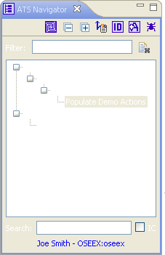
Populate Demo Data
Launch Application Server
Launch OSEE Client
Switch to the ATS Perspective
    Window
    Open Perspective
    ATS
    In the ATS Navigator Window
      Type “Populate” in the Filter text box
      Press ‘Enter’ to add filter
      Double-click on the “Populate Demo Actions” item
      Wait for operation to complete
  eclipse -vmargs -Xmx512m -Dosee.application.server=http://localhost:8089 -Dosee.authentication.protocol=demo

Slide 9
What is OSEE?
OSEE is a tightly integrated environment designed to support lean engineering principles across a product's full life-cycle in the context of an overall systems engineering approach.

Slide 10
Background
OSEE began was first deployed to develop Boeing’s next generation Apache Helicopter
It provides
  An integrated tool set
  End-to-end traceability
  Variant configuration management
  Integrated workflows and processes
  A Comprehensive issue tracking system
  Deliverable document generation
  Real-time project tracking and reporting
  Validation and verification of mission software

Slide 11
Background - continued
As an eclipse project
  Milestones
    Initial source committed on Dec 8, 2007 (~140K LOC)
    Project proposal approved on July 10, 2007
    Test environment framework submitted Spring 2009 (37K LOC)
OSEE is used to engineer itself

Slide 12
Architecture
Initially OSEE was architected as a heavy client
  Direct client-to-database interactions
Migrating into a Thin-Client/Server architecture
  Utilizing OSGI on server-side
  Flexible deployment and maintenance
  Address scalability and load management

Slide 13
Simple Network Layout
OSEE Datastore
Application server has access to the remote file system
Remote File
System
Relational Database
OSEE Application Server
192.168.1.110:8089
Single server acting as an arbitration server
After arbitration, client communicates with application server directly
OSEE Arbitration Server
192.168.1.110:8089
Client connects to arbitration server on start up. This is configured via JVM argument osee.arbitration.server
OSEE Client
192.168.1.200:8012
Notes:
We decided to use a remote file system for binary data storage – relational database performance was a consideration for the decision.
For this demo we are running all components on the same machine.
We can have each system running on a different PC – including the database and the remote file system
Only restriction is that an application server instance must have access to the data store components.

Slide 14
Third-Party Extensions and Legacy Software
Java/C/C++/Ada Dev
Backup/Restore
Multi Configuration
Project Mgmt/Planning
Building/Releasing
Team Config
Workflow Config
Metrics
Rich Traceability
Process Mgmt
Document Mgmt
Requirement Mgmt
Visualization
Blam Operations
Rules Framework
Publishing
Reporting
Messaging
Results Analyzer
Real Time Testing
Unit Testing
Reporting
Security
Task Scheduling
Database Analyzer
Training Services
Exemplary Applications Extensible Frameworks
Application
Development
Configuration
Management
Systems
Engineering
Requirements
Management
Testing
Environment
OSEE Application Framework
GEF
Zest
Plugin Dev Utilities
Extensible Rendering
Remote Event Service
Indexing & Tagging
Dynamic Searching API
Dynamic Artifact Model
Multi-Level Transactions
Multi-Level Branching
Data Store Adapter
Access Control
Version Control
Session Mgmt & Authentication
Object-Oriented Persistence
Web Tools Platform
BIRT
Nebula
CDT
JDT
Other
Eclipse Platform
Java Virtual Machine
JINI (Peer-to-Peer)
OSGI
Relational DB
Operating System (Windows, Linux, OSX, Solaris)
Notes:
OSEE’s Architecture extends the Eclipse Platform and provides it’s own extensions for use by the Applications that are built on top.
OSEE Application Framework provides the services necessary for the applications to share the common data model
Custom, Non-Engineering Environment Applications can be built on OSEE Application Framework and delivered to customers
OR Additional Applications can be plugged in to enhance OSEE’s already existing applications

Slide 15

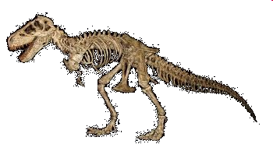
T. Rex Software Company
15 years in the business
Developing software for medical applications
Waterfall development cycle
Isolated teams using disconnected tools to track issues
  Requirements - using spreadsheets
  Code – problem change report database
  Test – spreadsheets and emails
Status is reported weekly via emails to team leads who then flow information to project managers

Slide 16
T. Rex Software Company
Inefficiencies/Cost
  Software license fees
  Steep learning curve
  Data redundancies
  Weak knowledge management
  Issues fall through the cracks
  Poor Planning
  Lagging metrics

Slide 17

SAW-TSR Project
Project with many challenges
Must develop a Surgical Assistant Workstation for Tele-operated Surgical Robots (SAWTSR)
Project was 40% under funded
Stringent requirements on software quality
  Medical application
  Severe consequences of faulty software
Project must meet a company wide initiative to streamline processes
If T. Rex does not make a change, the contract will be lost

Slide 18
Why should T. Rex use OSEE?
Full life-cycle engineering environment
Open source extensible platform
Benefits of eclipse community
Tightly integrated
  Common data model
  Version control
  Change management
  Workflows and processes
  Supports multiple databases
Zero license cost

Slide 19
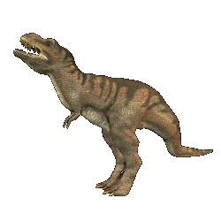
Company is ready to evolve!
Management decides to use OSEE

Slide 20
Where do we begin?
Analyze data produced during life-cycle
  Project produces various files
    System Level Requirements
    Software Level Requirements
    System Requirements
    Source Code
    Test Source
    Test Results
Determine how data relates to one another
Notes:
Windows File Folders
Data Sources

Slide 21
Document Trace
Product Decomposition
SAW
Requirements Traceability
Allocation
Video
Processing
…
Hydraulics
System
Requirement
System
Requirement
Requirement trace
3D
Capture
Control
Health
Subsystem
Requirement
Subsystem
Requirement
Subsystem
Requirement
Allocation
Design
Software
Requirement
Software
Requirement
Subsystem
Design
Implementation
Verification
Code
Unit
Code
Unit
Automated
Test
Test
Procedure
Notes:
Product Decomposition

Slide 22
Understanding the OSEE Data Model
Artifact
  Main OSEE data object consisting of attributes
  Artifact type - blue print for instance creation
  Artifact types can inherit from one another
  All artifacts inherit from “Artifact” (similar to Object in Java)

Slide 23
Attribute
Key / Value pair representing a single data element
Attribute type - blue print for instance creation
Attribute base type is used to convert raw data into a native type or other object
Attribute base types
  String
    Word Templated Content
    Word Whole Document
  Date
  Boolean
  Integer
  Floating Point
  Enumeration

Slide 24
Attribute - continued
Attribute backing data managed by an attribute data provider
  Transfers data between client/server
  Can be extended to serve data from outside OSEE data store
Attribute type also defines whether the attribute is searchable and how to tag the data

Slide 25
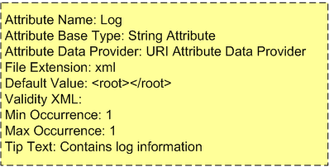
Attribute - continued
Application Server
Application
String Attribute
Base Type
To/From Datastore
Name
Data
URI Attribute
Data Provider
Log
<root>
<log…>
</root>
Attribute Instance
Attribute Type
Notes:
Attribute containing XML data transferred to/from datastore – converted to correct type via base type.

Slide 26
Relation
Relates two or more artifact types
Relation type - blue print for instance creation
  Relation type
    What type allowed on side A
    What type allowed on side B
    Multiplicity (1 to 1, 1 to Many, Many to Many)
Side A
1
*
Side B
Artifact Type
Artifact Type
Default Hierarchical Relation
Parent
Child

Slide 27

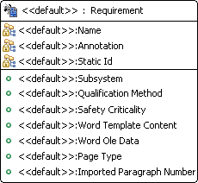
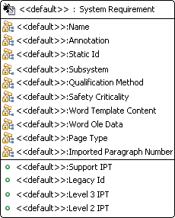
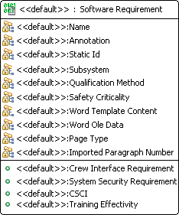
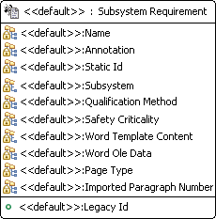
Artifact Types
Inherited Attributes
Inherited Attributes

Slide 28
Artifacts
Simple, User-definable Data Model
Artifact Instance
Software Requirement
Verification Relation
Test Unit
Name: Robot API
Name: Robot API Test
Paragraph Number: 1.1
Source: <Test Code>
Safety Criticality: E
Attribute Instances
Word Content: <……>
Notes:
The main components of the data model are:
Artifact – data objects
Attribute – state data on artifacts
Relations – Link artifacts to one another
All data types are strongly type and user definable

Slide 29
Version Control
Changes to artifacts, attributes, and relations are tracked by the system
Changes are managed by a transaction based version control system using fine grained change identification
Data managed under branches

Slide 30
Transaction
Transaction: 1000019
Timestamp: Mar 2, 2008
Author: Joe Smith
My Requirement
Time
Transaction: 1000020
Timestamp: Mar 3, 2008
Author: Alex Kay
My Requirement
My Code unit
My Test unit
Transaction: 1000021
Timestamp: Mar 4, 2008
Author: Joe Smith
My Requirement
My Code unit

Slide 31
Branch
System Root Branch
Project 1
3
Changes committed in transaction 4
4
Relation Changed
Transactions
Deleted Requirement
5

Slide 32
Variant Management
Product lines share common baseline data throughout all variants
Changes to the baseline product can be easily merged to the variant product lines
Product A
Release 1.0
Release 2.0
Release 3.0
Product A.2 (Product A w/ Additions)
Product A.3 (Product B w/ Additions)
Time

Slide 33
Branching
Branching
  Used to create a variant of the parent branch
  Updates can be performed to obtain changes from the parent branch into the child
A variant branch can be committed back into its parent
  Change conflicts are resolved via merging

Slide 34
Branching - continued
Commit into parent with no conflicts
Conflicts resolved in a merge branch before commit
Working Branch A
Program A
Update Program B with latest changes from Program A
Working Branch B
Merge Branch A
Program B

Slide 35
BREAK

Slide 36
From www.eclipse.org/osee to deployment
Tutorial (Part II: All in a days work)
Ryan Brooks
Donald Dunne
Roberto Escobar
Boeing
Mesa, AZ

Slide 37
Agenda
T. Rex with OSEE
  Products & Teams
  Variants
  Scenario Roles
  Project Workflows
Scenario: All in a days work
  Search Requirements
  Create Action
  Requirement Team Workflow
    Add Decision Review
    Change Implementation
  Code Team Workflow
    Add Tasks
  Test Team Workflow
    Privileged Edit
    Status
  Create Peer-To-Peer Review
  Add new Workflow

Slide 38
Project has been using OSEE for a couple of months now

Slide 39
Products & Teams
SAW – Surgical Assistant Workstation –
  Teams: Requirements, Code, Test, HW, SW Design
CIS – Dummy Project
  Teams: Requirements, Code, Test, SW Design
Facilities Team
IT Team
  Computers, Backups, Network
Tools Team
Website Team
Processes Team

Slide 40
Project Variants
Surgical Assistant Workstation - SAW
  Build 1
  Build 2
CIS Build 1 – Dummy Project
Work is performed in working branches which are then committed back into their respective parent branch
SAW Build 1
SAW Build 2
CIS Build 1

Slide 41
Roles
Project Manager
  Requirement
    Lead
    Developer
  Code
    Lead
    Developer
  Test
    Lead
    Developer

Slide 42
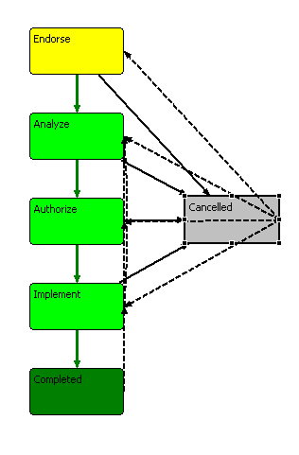
Workflow 1
Requirements
Code
Test
SW Design
Tools
Process
Notes:
Why move all action, issue, problem tracking to ATS?
1. Everyone has access to all data
2. As issue/problem is analyzed, other teams can be added to Action
3. Each team has it’s own independent workflow
4. Workflows can be simple or complex
5. One interface = Low cost of setup, deployment, training and admin

Slide 43
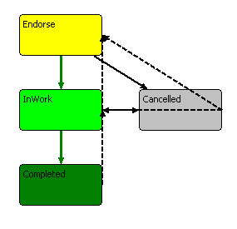
Workflow 2
Web
Facilities
Notes:
TODO - Whats CIS stand for?

Slide 44
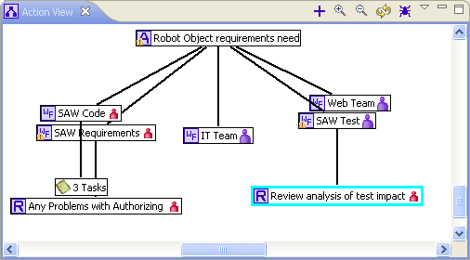
Scenario
Joe Smith finds a problem in a requirement impacting the following teams:
  Code
  Test
  Website
  IT
Reviews needed:
  Decision Review off Code Team Workflow
  Peer Review off Test Team Workflow
Perform tasks off Code Team Workflow
Notes:
Notes: You're welcome to follow along and perform the steps
- Limited time, so need to keep moving
- Will just explain some of the things going on versus showing due to time
- Will operate as more than one user, but will always say Joe Smith
- Will operate on single computer, this is multi-user/computer system with notifications

Slide 45
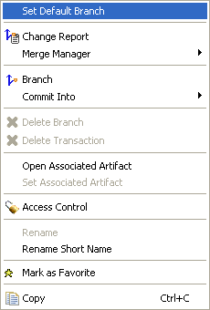
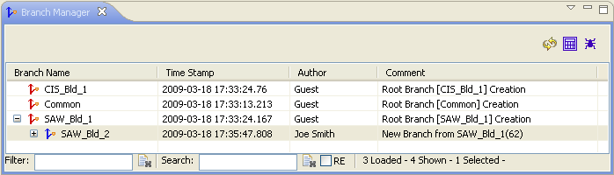
User searches for a requirement
Switch to the Define perspective
  Window->Open Perspective->Define
Set “SAW_Bld_2” as the default branch
  Click on the Branch Manager View
    If the view is not open
      Select Window->Show View->Branch Manager
  Right-Click on “SAW_Bld_2”
  Select “Set Default Branch”

Slide 46
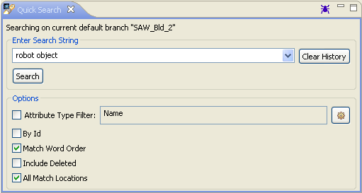
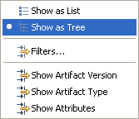
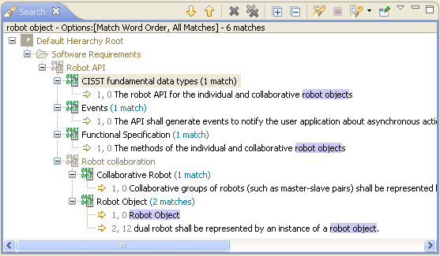
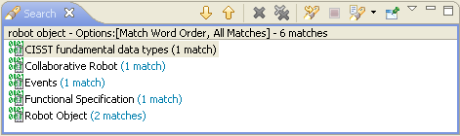
User searches for a requirement
Search for Item
  Click on the Quick Search View
  Enter “robot object” in the search string text box
  Check the “Match Word Order” option
  Check the “All Match Locations” option
  Click the search button
Search results as list or tree view with match locations
Select View

Slide 47
User explores the robot object requirement
From the search results view
  Right-Click on the “Robot Object” software
  requirement
  Select each of the following from the pop-up menu individually
    Reveal Artifact in Explorer
    Resource History
    Open With Artifact Editor
      Click on the attribute tab
      Click on the relation tab
    Open With MS Word Preview
    Sky Walker

Slide 48
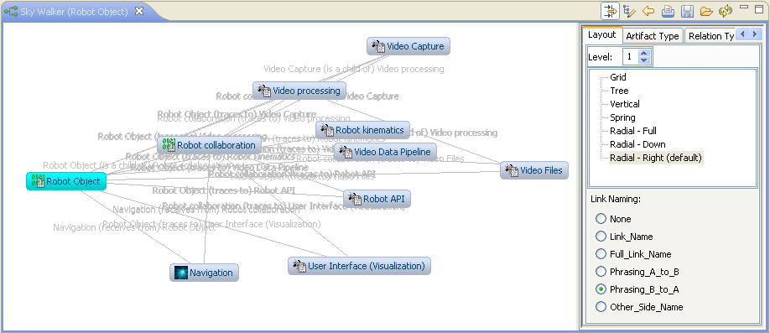
User explores the robot object requirement
Robot Object (software requirement) relates to other artifacts
Notes:
While looking through the robot object requirement, the user notices a problem.
An action will need to be written against it.

Slide 49

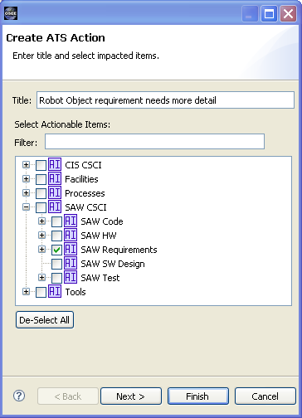
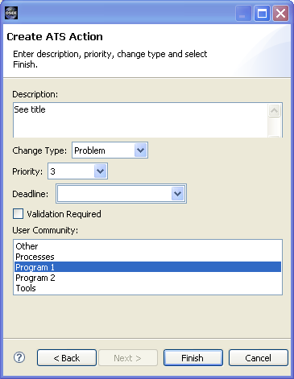
User creates an action
Create an action against the “Robot Object Requirement”
Switch to the ATS Perspective
  Window->Open Perspective->ATS
Click on the New Action icon in ATS Navigator
  Fill-in the Create ATS Action Dialog:
Next

Slide 50
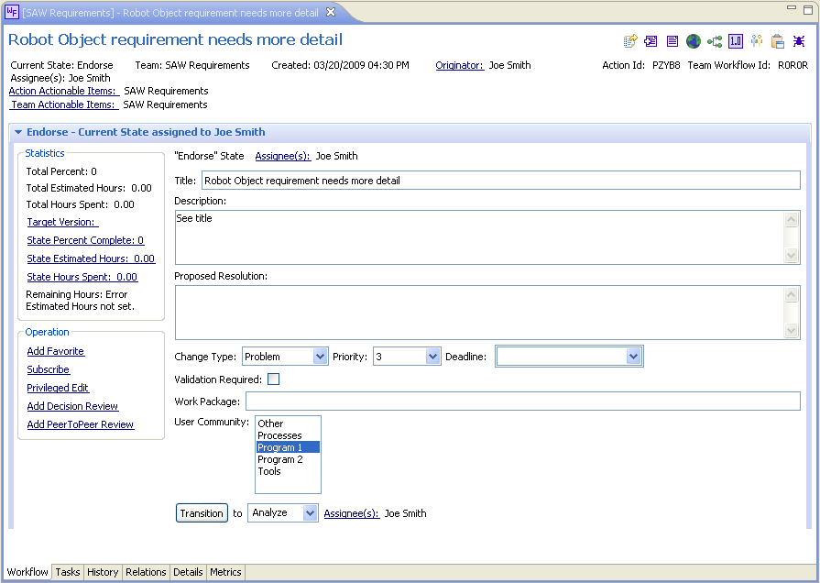
User creates an action
Automatically assigned to team lead
Notes:
Action created, assigned to Joe Smith (configured Lead for SAW Req Team)

Slide 51
Requirements lead approves requirement team workflow
Requirements Team Lead - Joe
  Endorses Action
Sets Target Version
  SAW Build 2 (the next version)
Changes priority to 2
Transitions state to “Analyze”
  This is where the lead would normally assign another user to complete the work
  NOTE: We will not change the assigned user for the demo

Slide 52
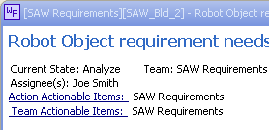
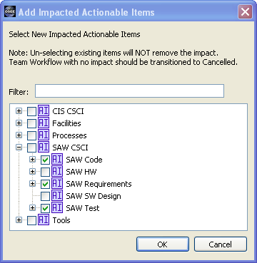
Requirements developer analyzes requirement team workflow
Requirements Developer - Joe
  Analyzes Action
Sets proposed resolution to “Fix It”
Change will impact code and test
Add code and test workflows
  Select “Actionable Items” hyperlink
  Add SAW Code
  Add SAW Test
Action View shows new workflows
Email has been sent to leads
Transitions to Authorize
Notes:
NOTE: Can be reassigned or configured to be auto-assign

Slide 53
Requirements lead begins to authorize the requirement team workflow
Requirements Team Lead - Joe
  Authorizes Action
Sets Work Package to A324324A
Team lead needs concurrence from Kay (The Manager)
  A decision review is needed

Slide 54
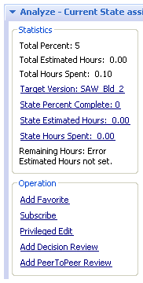
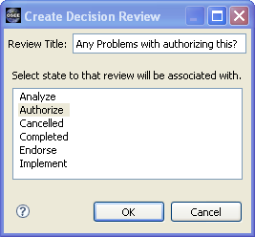
Requirements lead creates a decision review
Create Decision Review
  Select Add Decision Review
  Fill-in the Create Decision review Dialog:

Slide 55
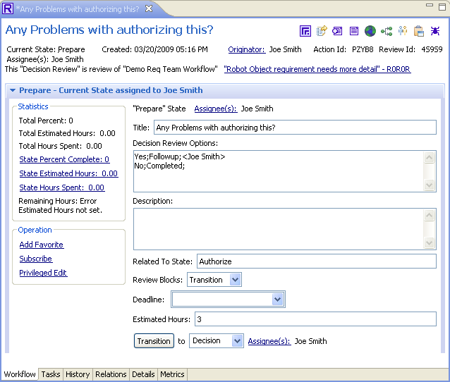
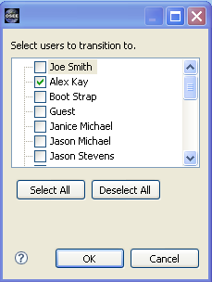
Requirements lead prepares the decision review
Prepare Review
  Set Review Blocks to Transition
  Set Estimated Hours to 3
  Assign to Alex Kay
  Transition the review

Slide 56
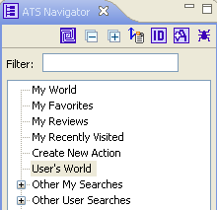
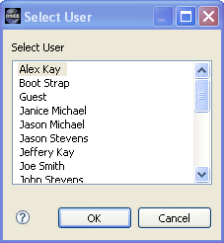
Manager approves the change
Alex Kay checks his assigned work
Runs “My World”
  Select “User’s World”
  Select Alex Kay
From Alex Kay’s “User’s World”
  Select the “Decision Review”
  Kay decides Yes
  Transitions the Review to Completed

Slide 57
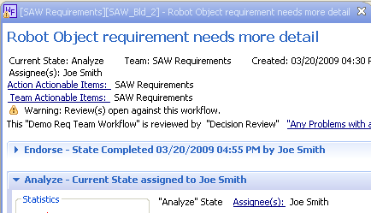
Requirements lead completes authorization
Sets Estimated Hours to 2.5
Transition to Implement
Notice that before Alex Kay had completed the decision review, Joe was not able to transition to the next state

Slide 58
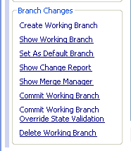
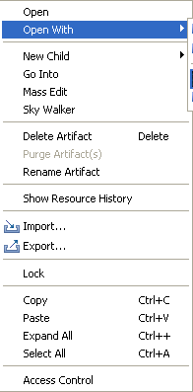

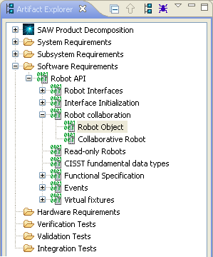
Requirements developer implements a change
From the Implement State
  Select “Create Working Branch”
  Set the working branch as the default branch
Using Artifact Explorer, navigate to the “Robot Object” software requirement
Right-Click on “Robot Object”
From the pop-up menu, select “Open With”
Select “Artifact Editor”

Slide 59
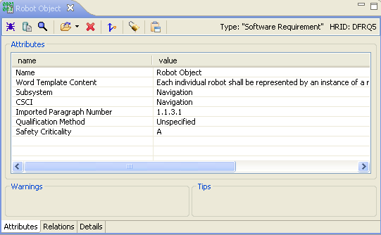
Requirements developer implements a change
Select the attributes tab
Change Qualification Method to Inspection
Save by clicking
File->Save

Slide 60


Requirements developer implements a change
From the “Artifact Editor’s” toolbar
  Click on “Open With” down arrow
  Select MS Word Edit
    NOTE: If you don't have MS Word, just watch
Insert into word document
  “Need more information here.”
Save document and close
  “Artifact Editor’s” Word Template Content Attribute should update accordingly

Slide 61
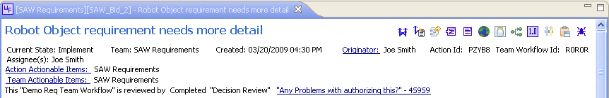
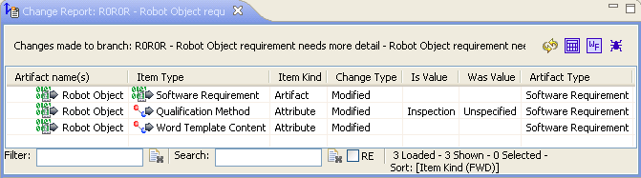
Requirements developer implements a change
Switch to the Workflow Editor
Select “Show Change Report” from the tool bar item

Slide 62
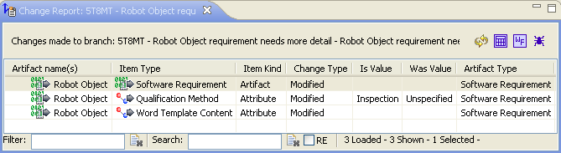
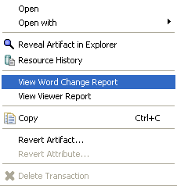
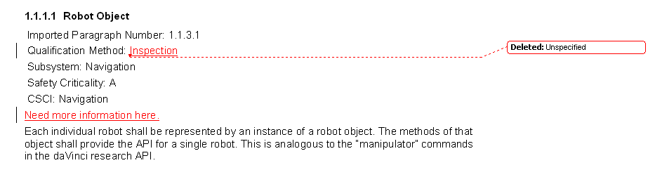
Requirements developer implements a change
From the Change Report View
Right-click on the “Robot Object” software requirement
Select “View Word Change Report” from the pop-up menu

Slide 63
Requirements developer implements a change
Select "Commit Working Branch“ to apply changes to the parent branch “SAW_Bld_2”
Transition to Complete

Slide 64
Code lead endorses code team workflow
Sets Work Package to A234532
Transitions to Analyze
Notes:
Remind that this was created in the analyze action by the requirements lead

Slide 65


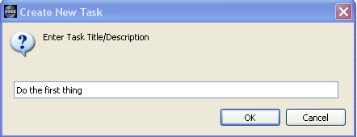
Code developer analyzes team workflow
Sets Estimated Hours to 10
Analysis Requires Tasks
  Switch to the Tasks Page by clicking on the Task Tab
  Add a Task by clicking on the “New Task” tool bar item
  In the “Create New Task” dialog enter “Do the first thing”
  Click “OK” to close the dialog

Slide 66
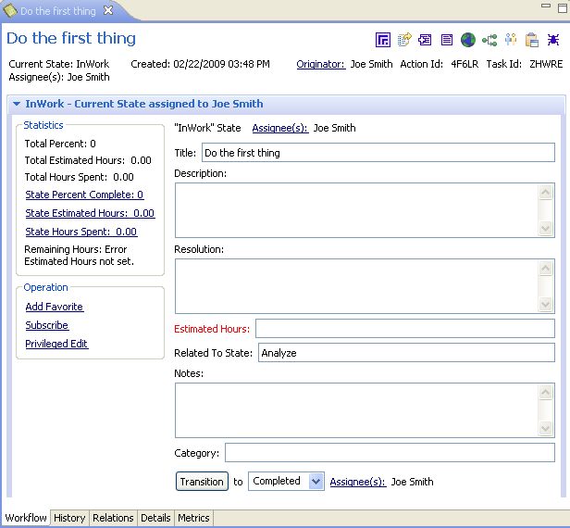
Code developer analyzes team workflow
Double-click on the new task to open the Task Editor
Click on Assignee(s) to assign a different user
Close Task Editor
Add two more tasks
Transition code team workflow to Authorize

Slide 67
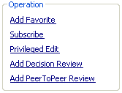
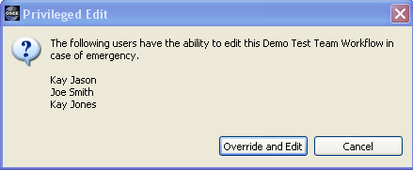
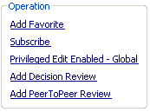
Test lead endorses test team workflow
Test Lead – Joe
  Estimates the work
Kay Jones is not in today and estimates are due...
Joe will need to get edit privileges to transition the workflow
Click on “Privileged Edit” to display the “Privileged Edit” dialog
Click on “Override and Edit”
Transition To Analyze
Set Estimated Hours to “25”
Notes:
Remind that this was created in the analyze action by the requirements lead

Slide 68
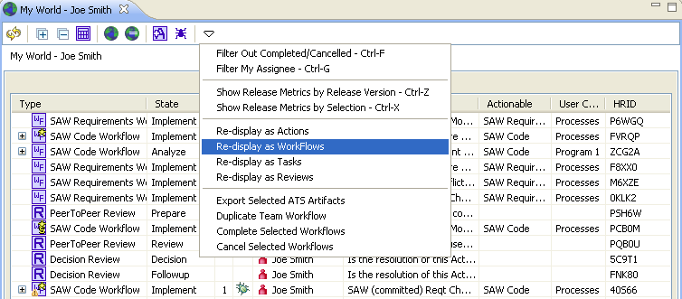
Manager wants status
Manager – Alex Kay
  Needs status report
Select “World”
Redisplay as workflows

Slide 69
Manager wants status
Click on “Metrics Tab” to open the Metrics Page
Set “Estimated Completion Date” to 2 Days from the current date
Kay won't make it (slacker); Joe will

Slide 70
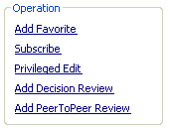
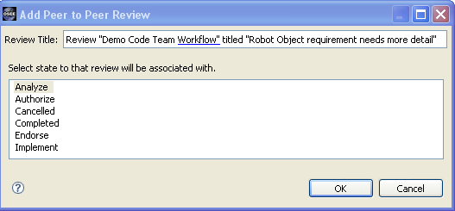
Code developer adds a peer review
Code Developer – Joe
  Realizes he needs a peer review for Analysis
Add Peer-To-Peer Review
  Click on the “Add PeerToPeer Review” hyperlink
  In the “Add Peer to Peer Review” dialog, select “Analyze” state
  Click “Ok”

Slide 71
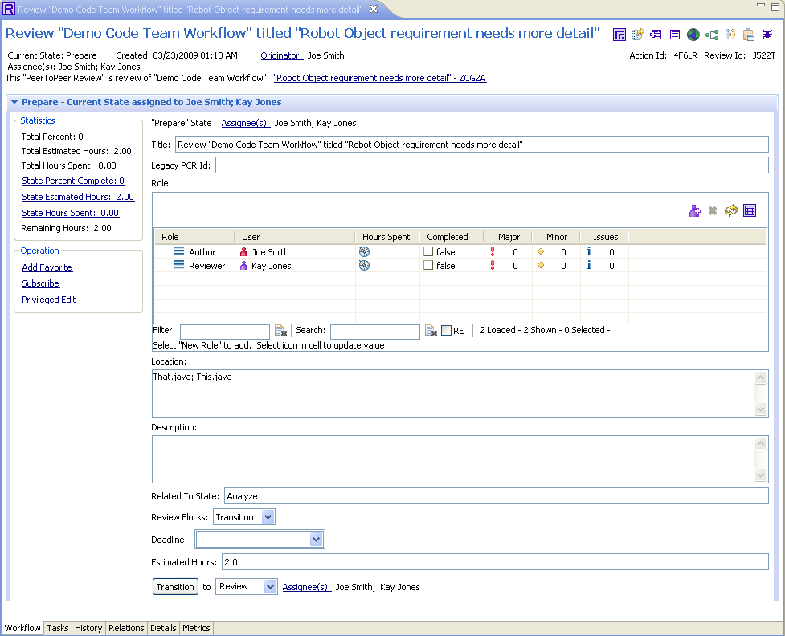
Code developer adds a peer review
Click on the New Role tool item to add 2 reviewers
Set one of the roles to “Author” and the other to “Reviewer”
  Edit the “Role” field so by clicking on the field while pressing the “ALT” key
Set Location to “That.java; This.java”
Set Blocking to “Transition”
Set Estimated Hours to “2”
Transition to Review
ALT+Click to edit field

Slide 72
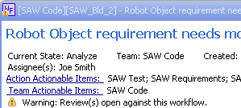
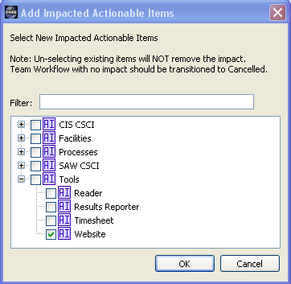

Code developer creates a tool team workflow
Code Developer – Joe
  Realizes the change will affect the Tools Team
Select the “Action Actionable Items” hyperlink from the SAW Code Workflow
Select “Website” from the “Add Impacted Actionable Items” dialog
Workflows are created for the Website Team

Slide 73
BREAK

Slide 74
From www.eclipse.org/osee to deployment
Tutorial (Part III)
Ryan Brooks
Donald Dunne
Roberto Escobar
Boeing
Mesa, AZ

Slide 75
Agenda
Deployment: Things to consider
Administrator Access
Creating a Baseline Branch
Customizing the data model
Importing the data model
ATS Configuration
Extensibility
Notes:
Hand-out Flash Drives
Ask people to follow readme.

Slide 76
Deployment: Items to Consider
Remote access to data store
Hardware considerations
  Database server
  Application server
Requirements
  Microsoft Office
  Database Server
    PostgreSql
    Oracle Server

Slide 77
Granting Administrator Access
Set Default Branch to Common
Open the User Groups Folder
Open “OseeAdmin” with Artifact Editor
Click on the Relations Tab
Perform a Quick Search
  Check the Attribute Type Option
    Ensure it is set to Name
  Uncheck all other options
Drag and Drop the user “Joe Smith” into the Users relation
You are now an OSEE Admin

Slide 78
Creating a Baseline Branch
Ensure you have OSEE Admin privileges
Refresh the branch manager view
You should now be able to see the “System Root” branch
Right-click on the “System Root” branch and select “Branch” from the pop-up menu
A child branch of the “System Root” branch will be created

Slide 79
Data Model Customization
The data model in OSEE is extensible and user configurable
Users can define new artifact, attribute, and relation types and their constraints such as multiplicity and applicability
Type inheritance allows similar types to be defined and modified without tedious redundancy because similar types inherit what is common from their super type

Slide 80
Data Model Customization - Spreadsheet
The OSEE data model is defined using a tabular format involving 5 tables.
The full data model can be defined using a single spreadsheet or be divided among multiple spreadsheets that can reference types defined in any spreadsheet.
See the following xml spreadsheet OseeTypes_ProgramAndCommon.xml for an example.

Slide 81
Data Model Customization – Table 1 - Artifact
Factory Class – Retired in 0.7.0
Artifact Type Name - Any valid UTF-8 characters with a max length of 75 bytes
Super Type Name - The super artifact type from which this type will inherit associated attributes and relations. Another concrete artifact type or an abstract one that exists only in data model definition.

Slide 82
Data Model Customization – Table 2 - Attributes
Attribute Base Type - Fully qualified java class name of a class that extends org.eclipse.osee.framework.skynet.core.attribute.
The typical and simplest case is to specify one of the built-in types (StringAttribute, BooleanAttribute, etc…) If a custom java type that extends Attribute is needed, then that type should be specified here.
Attribute Type Name - Any valid UTF-8 characters with a max length of 500 bytes
File Extension - Any valid UTF-8 characters with a max length of 50 bytes; only applies when using the org.eclipse.osee.framework.skynet.core.UriAttributeDataProvider
Tagger ID - If the attrbiute’s content is to be included in the search index for the quick search, use DefaultAttributeTaggerProvider, otherwise leave blank.
Default Value - The initial value given an attribute upon initialization, this may be left blank
Validity Xml - For the attribute base type org.eclipse.osee.framework.skynet.core.EnumeratedAttribute, specifies the valid enumerations. For example, <Page_Type><Enum>Portrait</Enum><Enum>Landscape</Enum></Page_Type>
Min Occurrence - The framework with prevent having lest than this number of this attribute type on a single artifact
Max Occurrence - The framework with prevent adding more than this number of this attribute type to a single artifact
Tip Text - Text to describe an attribute. Any valid UTF-8 characters with a max length of 4000 bytes

Slide 83
Data Model Customization – Table 3 - Artifact Type / Attribute Type Mapping
Artifact Type Name - Exact name of an artifact type defined above (or previously)
Attribute Type Name - Exact name of an attribute type defined above (or previously) to be associated with the corresponding artifact type

Slide 84
Data Model Customization – Table 4 - Relation Type
Relation Type Name - Any valid UTF-8 characters with a max length of 50 bytes
Side A Name - Descriptive name for the A side of the relation. Any valid UTF-8 characters with a max length of 50 bytes
A to B Phrase - An optional phrase that describe the relation between the artifacts from the side A perspective. Any valid UTF-8 characters with a max length of 50 bytes
Side B Name - Descriptive name for the B side of the relation. Any valid UTF-8 characters with a max length of 50 bytes
B to A Phrase - An optional phrase that describe the relation between the artifacts from the side B perspective. Any valid UTF-8 characters with a max length of 50 bytes
Short Name - Five or less characters is typical. This abbreviated name is used in the user interface when space is at a premium
Ordered - Yes to have artifacts on the same side of this relation type use a user defined ordered, otherwise No

Slide 85
Data Model Customization – Table 5 - Artifact Type / Relation Type Mapping
Artifact Type - Exact name of an artifact type defined above (or previously)
Relation Type - Exact name of an relation type defined above (or previously)
Side A Max - An artifact of type "Artifact Type" can be on side "A", "Side A Max" number of times for relation links of type "Relation Type“
Side B Max - An artifact of type "Artifact Type" can be on side "B", "Side B Max" number of times for relation links of type "Relation Type"

Slide 86
Data Model - Add Artifact, Attribute and Relation
Open OseeTypes_ProgramAndCommon_New.xml spreadsheet (5 highlighted lines were added)
Added Artifact Type: System Function
Added Attribute Type: Safety Criticality
  Enumeration:<Criticality><Enum>A</Enum><Enum>B</Enum><Enum>C</Enum><Enum>D</Enum><Enum>E</Enum></Criticality>
Added Artifact to Attribute Mapping
Added Relation Type: Design
Added Relation to Artifact Mapping

Slide 87
Import OSEE Data Model
To import changes to the data model for an existing OSEE database:
  File -> New -> Other -> OSEE -> Osee Types
  Select File “OseeTypes_ProgramAndCommon_New.xml”
  Select Branch “Common”
  Select Finish
To automatically import the data model during database initialization use the extension point org.eclipse.osee.framework.skynet.core.OseeTypes

Slide 88

Import OSEE Data Model – Try It - 1
Let’s create a “System Function” folder and a new “System Function” artifact
Set Default Branch -> SAW_Bld_1
In Artifact Explorer, right-click -> New Folder -> Name: “System Function”
Select “System Function” -> right-click -> New Child -> “System Function” -> Name: “Robot Movement”

Slide 89

Import OSEE Data Model – Try It - 2
Let’s set the “Safety Criticality” attribute of our new “Robot Movement” system function.
In Artifact Explorer, Double-click to open new “System Function” artifact called “Robot Movement”
Switch to the attributes tab of the “Robot Movement” artifact
Modify the “Safety Criticality” value to “C”
Save

Slide 90
Import OSEE Data Model – Try It - 3
Let’s drag an existing Software Requirement into the new “Robot Movement” “System Function” artifact.
In Artifact Explorer, Double-click to open new “System Function” artifact called “Robot Movement”
Switch to the relations tab of the “Robot Movement” artifact
Under “Software Requirements” -> drag any requirement into “Design” relation
Save

Slide 91

Import OSEE Data Model – Success!

Slide 92
ATS Configuration
ATS uses OSEE framework Artifacts, Attributes and Relations to store configuration information
Configuration changes can be done using framework editors and views
Configurations can be done dynamically in OSEE without need for code release
Major changes such as new widget types, advanced algorithms for assignment/routing, customized searching can be done through Eclipse extension points

Slide 93

ATS Configuration – Team Definition
Artifact in OSEE represents a team that is responsible for performing work
Configured with users that perform roles
  Team Lead – Endorses Team Workflow, Assigns Work
  Team Member – Performs Work on Team
  Privileged Member – Able to override assignee and edit any field in Team Workflow
Related to Actionable Items that they are responsible for
Related to Workflow Configuration that defines how this team does it’s work

Slide 94

ATS Configuration – Team Definition

Slide 95

ATS Configuration – Actionable Item
Artifact in OSEE represents a real or conceptual object that the user would write an Action against
Active Flag enables items to be retired
Related to Team Definitions that are responsible for them

Slide 96

ATS Configuration – Work Flows
Artifact in OSEE represents a how a team performs it’s work
Represented by a state machine with Work Pages being states
Related to Team Definitions uses them
Related to Work Pages and Work Rules that apply

Slide 97
ATS Configuration – Work Flows

Slide 98

ATS Configuration – Work Pages
Artifact in OSEE that represents a a state in a Work Flow
Represented by a state machine with Work Pages being states
Related to Work Flow they belong to
Related to Work Rules and Work Widgets

Slide 99

ATS Configuration – Work Widgets
Artifact in OSEE that represents a a single Widget to display for a Work Page
Contains some formatting information
Includes information relating widget contents to storage attribute
Related to Work Page they belong to

Slide 100

ATS Configuration – Work Rules
Artifact in OSEE that represents a rule to be applied to Work Flow or Work Page
Backed by code that provides the functionality described
ATS provides built in rules for use by work flows
New rules can provided through extension points

Slide 101

ATS Configuration – Work Pages, Widgets, Rules

Slide 102

T. Rex – Let’s track a new SAW Lab
File -> New -> Other -> OSEE ATS -> Create ATS Configuration
Select “Populate with example entries” button

Slide 103


Re-Organize Team Definitions and Actionable Items
In Artifact Explorer:
Move New “SAW Labs” Team Definition under “SAW SW” Team
Move New “SAW Lab” Actionable Items under “SAW CSCI” Item
becomes

Slide 104

Configure Team Leads and Members
Search Pulldown – Artifact Search – Artifact Type – User – Add Filter - Search
From Search Results:
  Drag “Janice Michael” to TeamLead
  Drag “Keith Johnson” and “Michael Alex”” to TeamMember
  Drag “Kay Jones” to Privileged Member
  Save

Slide 105

Let’s Try It…
ATS Navigator – New Action – Lab Computer Actionable Item
Complete Action Wizard
Notice:
  Endorse State assigned to both leads “Janice” and “Joe”
  Privileged Edit allows “Kay Jones” to override

Slide 106

Labs Team wants a different workflow
File -> New -> Other -> OSEE ATS -> Create ATS Workflow

Slide 107
Set new Labs team workflow config
Double-click “SAW Lab” Team Definition
Switch to Relations tab
Expand “Work Item”
Select item “osee.ats.teamWorkflow” and right-click – “Delete Relation”
From Artifact Explorer, drag workflow “org.trex.saw.labs” to Work Item – Child
Save
Restart OSEE

Slide 108

Add a PreAuthorize state…
Click “State” and click in editor area
Add “Default Transition” from Analyze to PreAuthorize and from PreAuthorize to Authorize
In Properties view, change state name to PreAuthorize (Note: id will be updated automatically)
Save

Slide 109
Let’s try new PreAuthorize state
ATS Navigator – New Action – Lab Computer Actionable Item
Complete Action Wizard
Transition through to “Implement” state and note that new PreAuthorize state exists

Slide 110

PreAuthorize needs some widgets
Artifact Explorer
Double-click “org.trex.saw.labs.PreAuthorize” “Work Page”
Switch to Relations tab
Drag in Resolution and Work Package widgets from “Work Widgets”
Restart OSEE and open Action from “My World”

Slide 111
PreAuthorize needs a Rule
Artifact Explorer
Double-click “org.trex.saw.labs.PreAuthorize” “Work Page”
Switch to Relations tab
Drag in “atsRequireTargetedVersion” rule from “Work Rules”
Restart OSEE and open Action from “My World”
Transition back to Analyze, then PreAuthorize, then Implement – Get stopped until set “Targeted Version”

Slide 112
Advanced customization / extensibility
New Attributes can be added to Team Workflow artifacts
New Widgets can be created
  Simple – attribute with existing XWidget xml
  Advanced – new XWidget with attribute or other storage (artifacts, relations, etc…)
New Rules can be created
Teams and States can have java backed algorithms that enforce or automate tasks (eg: emailing team leads, requiring review if estimated hours > 30, etc…)

Slide 113
Other Extensibility
Provide customized editors for artifacts
Attribute Data Providers
Renderers
Indexed based taggers
Authentication Protocols
Resource Management Protocols
Artifact Types and Factories
Customized Dictionaries
XWidget Providers

Slide 114
We have made it to the end!
Feedback Questionnaire
See you tonight at 7:30 pm - Great America 2 for Birds of a Feather
Other OSEE Talks at EclipseCon 2009
  “XViewer - An SWT Widget with the power of the spreadsheet”
    Wednesday Mar. 25th 4:50 pm - Room 203/204
  “An Integrated Test Environment for Systems Engineering”
    Wednesday Mar. 25th 11:30 pm - Room 203/204
  “Unlocking the OSEE Core Framework”
    Thursday Mar. 26th 10:40 am – Grand Ballroom B

Slide 115
For further help with OSEE
  http://www.eclipse.org/osee
    Newsgroup (Do not use the Mailing List)
    Documentation
    FAQs

Slide 116
Legal Notices
Java and all Java-based trademarks are trademarks of Sun Microsystems, Inc. in the United States, other countries, or both.
Other company, product, or service names may be trademarks or service marks of others

Slide 117
Show diagram of each team's workflow
- Diagram of Action, Workflows, Reviews, Tasks
- Diagram of Team Definitions and Actionable Items
- Work Flows, Pages, Widgets, Rules
- Versions
- Groups
- Users / User Groups
- Configuration of ATS
- ATS Configuration
- New -> Other -> OSEE ATS -> ATS Configuration
- Configuration Namespace: org.myCompany.labs
- Team Definition Name: Labs Team
- Actionable Item(s): Lab 1, Lab 2, Lab Door, Lab Computer
- Versions:
- Workflow Id: osee.ats.defaultTeamWorkflow

